Slide 1
Mobile Apps Reference Architecture (MARA)
Jarno Montonen

Slide 2
Why?
Many apps we create have very similar architectural requirement
Avoids reinventing the wheel
Speeds up development
Improves code quality
Makes it easier for developers to move between projects
Serves as reference context for training new developers
Contribute back to the community
Improve our reputation as quality developers

Slide 3
What?
Define the common requirements via discussions, document as text
Define architecture for each layer, document as text and diagrams
Data Access
Business Logic
View Model / Controller
View / Presentation
Create reusable OS implementations as part of customer work (and hackathons)
Code snippets
Project templates
Components

Slide 4
How?
Sit down with volunteers once a week for 1-3 hours
Take notes
Work on the documentation in between
https://github.com/futurice/mobile-apps-reference-architecture

Slide 5
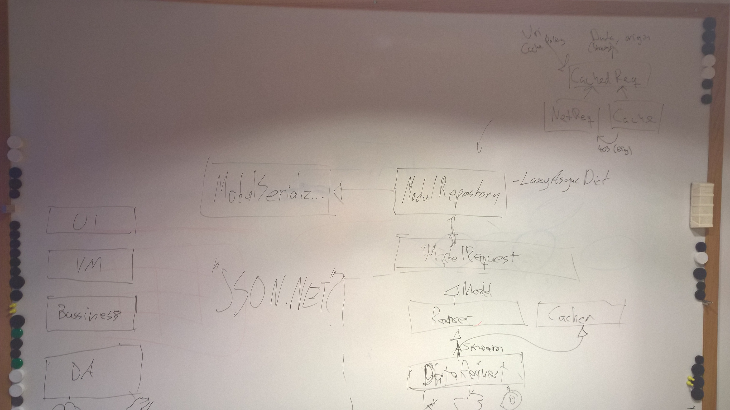

Slide 6
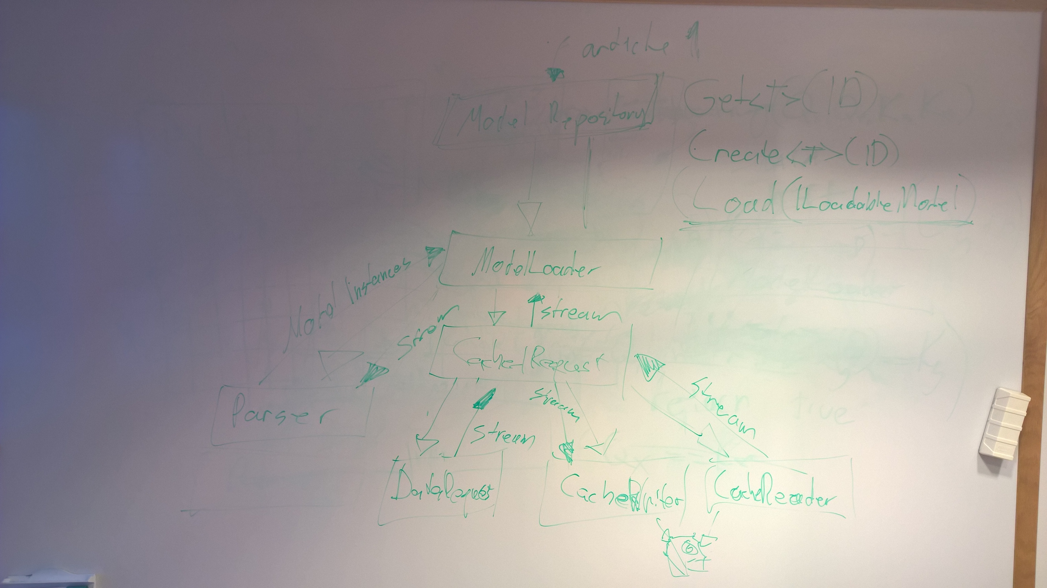

Slide 7
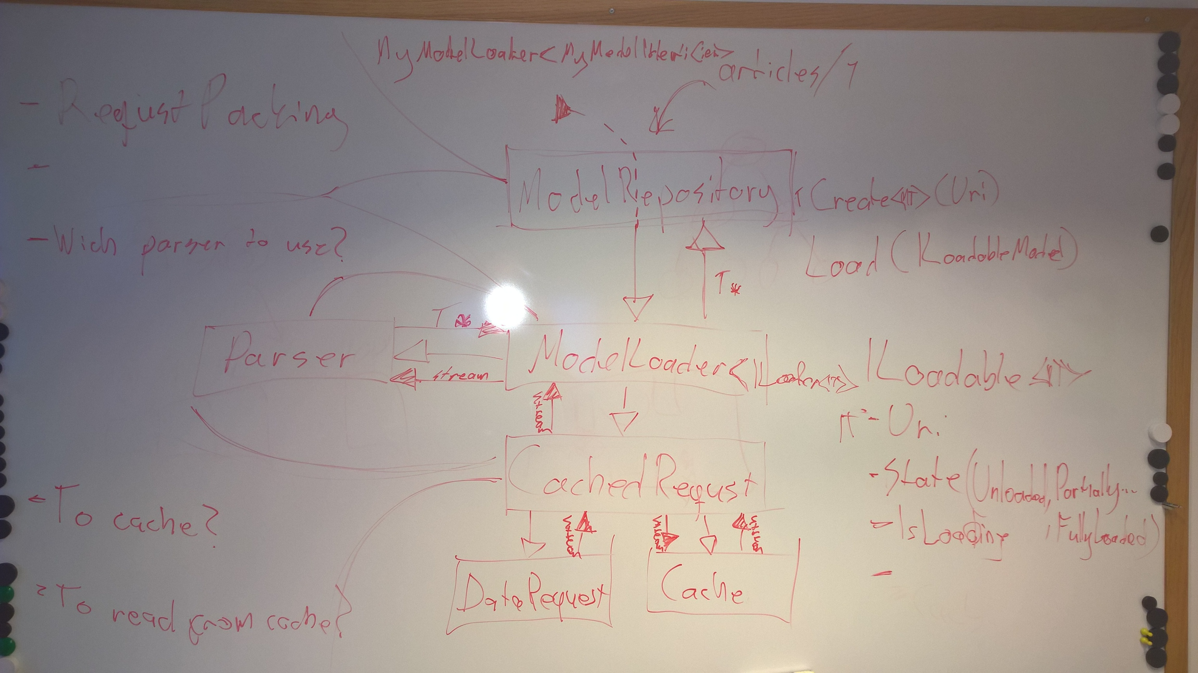

Slide 9
Thanks
Join:

